Slide 1
Agile Planning
Dirk Riehle, Univ. Erlangen
AMOS B04
Licensed under CC BY 4.0 International

Slide 2
Agenda
Product goal
Product glossary
Backlog items
Scrum backlogs
Definition of done
Sprint planning
Release planning
Roadmapping

Slide 3
1. Product Goal

Slide 4
Product Goal [1]
The product goal is
The purpose of undertaking the project
To resolve the product / project conflict, AMOS separately defines
Product vision and project mission
[1] Introduced only in the Scrum 2020 guide

Slide 5
Product Vision
The product vision is the
Timeless reason why the software under development should exist
The product vision should contain a sustainability model
Business value of why someone pays for the development
The Flowers social network helps flower enthusiasts worldwide to connect with each other and enjoy following their favorite hobby online. Centered on showing and rating favorite flower photos, it inspires growing and presenting ever more beautiful flowers. With a highly engaged user community, Flowers is the best place for producers and sellers of gardening supply to reach out to customers and engage with them. Such engagement involves understanding flower enthusiasts’ needs around gardening supplies and selling to them.

Slide 6
Project Mission
The project mission is
What the team has committed to achieving within the given project time-frame
The mission of this project is to create an MVP for Wahlzeit with the Flowers extension. Core functionality will be showing and rating photos, basic user management, case management, and minimal system administration.

Slide 7
One-Time Deliverable: Product Vision and Project Mission
Please define and agree on product vision and project mission
If necessary, update vision and mission during the project

Slide 8
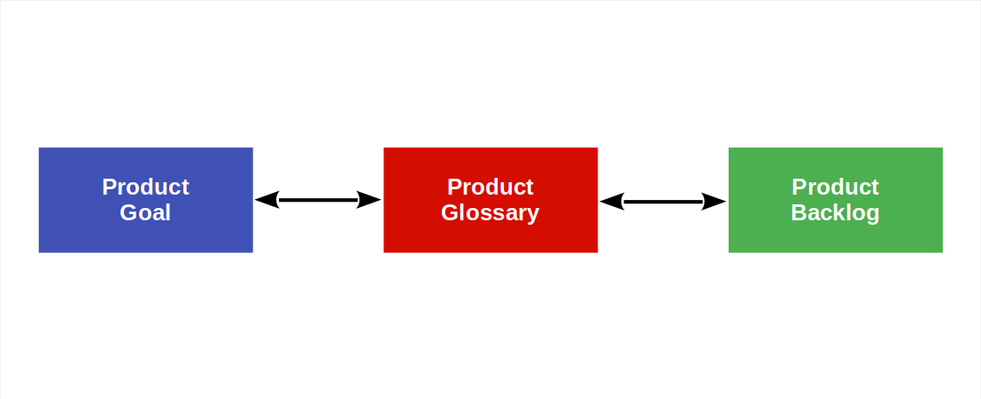
Product Goal / Product Glossary / Product Backlog

Slide 9
2. Product Glossary

Slide 10
Product Glossary
A product glossary is a
List of domain concept (term) definitions
Domain concepts can be
Original concepts, synonyms (links), shorthands, …
A glossary is a poor man’s approach to a domain model
Lack of formality doesn’t necessarily make it easier
In AMOS, the domain is the application domain

Slide 11
Example Domain Glossary
Term | Definition
Photo | A photo is an image uploaded by a user for display as part of the user’s photo portfolio
Photo rating | A short-hand for either individual or community photo rating
Individual photo rating | An integer value of 1..10 that a user gives to a photo shown to them
Community photo rating | A rational value of 1..10 that is the average of all individual photo ratings
Photo status | The status of a photo within the Wahlzeit system (uploaded, published, etc.)

Slide 12
Common Mistakes and Best Practices
Common mistakes
Lack of precision / not thinking
Confusing application with technical domain
Redundant definitions
Best practices
Work from first principles i.e. “is a” (supertypes)
Avoid redundancy by building terms on each other

Slide 13
Regular Deliverable: Product Glossary
Please create a product glossary and keep it up-to-date

Slide 14
3. Backlog Items

Slide 15
Backlogs and Backlog Items
Backlog items are items in a backlog
Product backlog → product backlog items
Sprint backlog → sprint backlog items
Impediments backlog → impediments

Slide 16
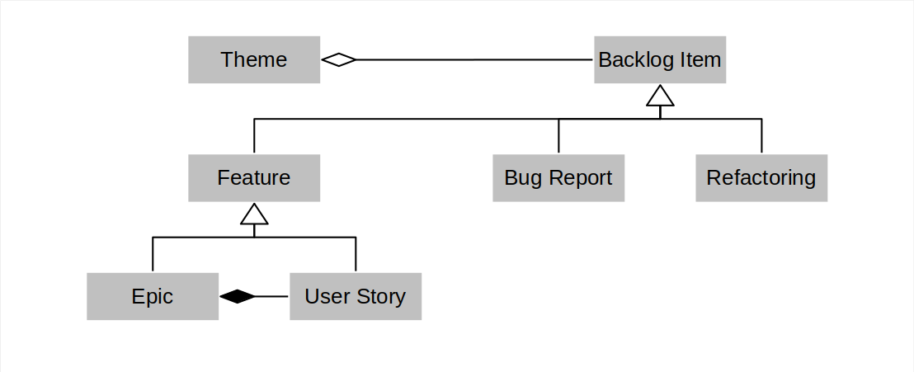
Types of Product and Sprint Backlog Items

Slide 17
Features, Refactorings, and Bug Fix Requests
A feature is
A distinguishing characteristic of a software item [IEEE 829]
A refactoring (request) is
A behavior-preserving code transformation to improve quality
A bug fix request is
A bug report where the bug is to be fixed against the underlying feature

Slide 18
Epics and User Stories
An epic is
A large feature awaiting break-down into smaller features
A placeholder for these smaller features
A user story is
A feature presented using a the user-story-pattern that is
Small enough to be implemented in a sprint

Slide 19
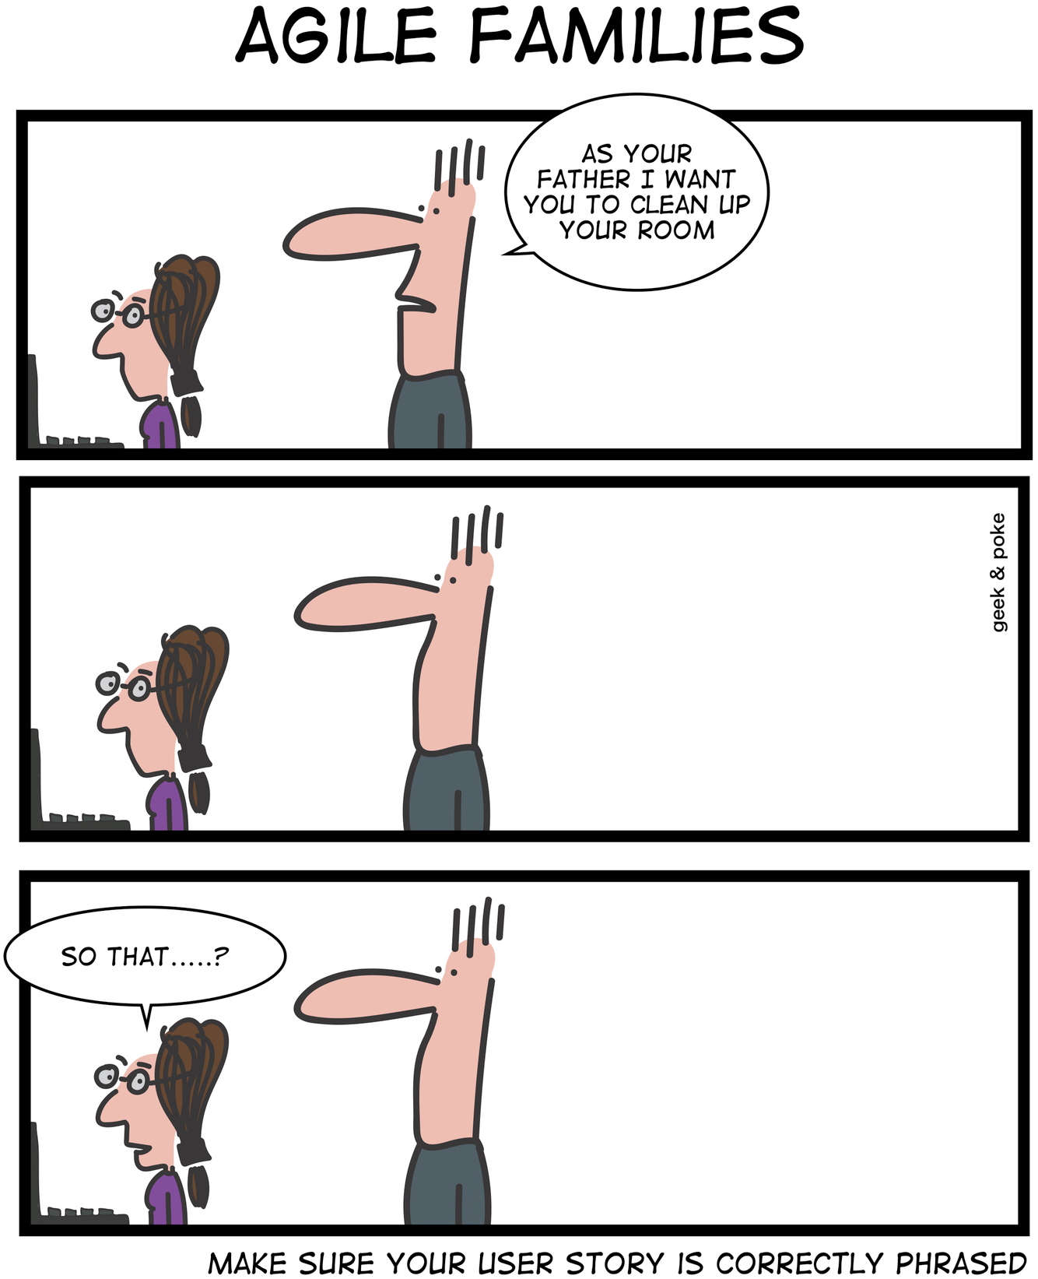
User Stories
A user story is a feature described using a pattern of
As a [user role]
I need a [function] so that
I get [business value]
User stories are discussion starters, not specifications
Tell-a-Friend: As a Flowers user, I need a function to tell a friend about a flower photo, so that I can share my passion for flowers and increase my network.

Slide 20
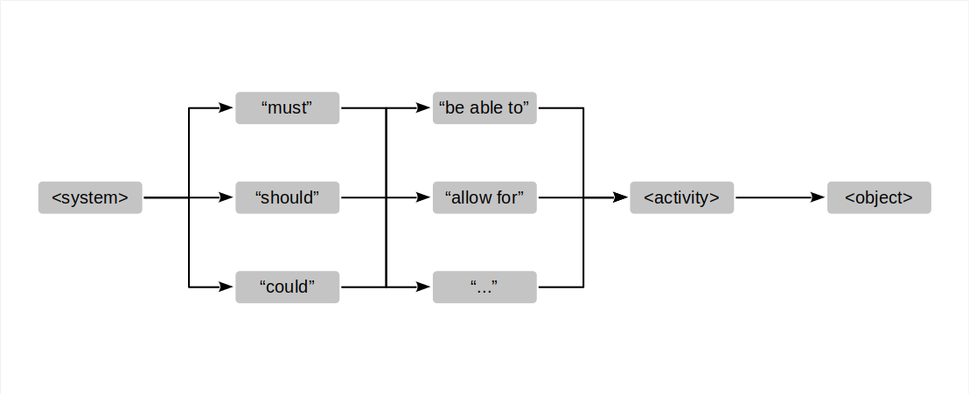
Common Alternative to User Stories

Slide 21
Quality Criteria for Backlog Items
I | ndependent: Items should be independent of each other
N | egotiable: An item can be questioned and revised
V | aluable: An item should have recognizable business value
E | stimatable: An item should be sufficiently precise to estimate a size
S | mall: An item should be small enough to fit into one iteration
T | estable: An item should have testable success criteria

Slide 22
Acceptance Criteria
An acceptance criterion for a backlog item is
A proposition that must be true before the item can be accepted
Acceptance criteria are the list of required propositions
Acceptance criteria are specific to the backlog item

Slide 23
Story Points
Story points
Is an arbitrary numeric measure of size of a given backlog item
Properties
Is a measure of size, not of effort or duration
Measured in non-linear increments, forcing choice
Is socially agreed upon, depends on team estimation history
Is independent of a particular person (and their skills)
Is mapped to time using the team's velocity (development speed)
Points | Meaning
0 | No size
1 | Trivial size
2 | Small size
3 | Medium size
5 | Large size
8 | Very large size
13 | Too large (size)

Slide 24
Size vs. Effort
Size is
Measured in an arbitrary unit
An estimate of complexity
Independent of time
Does not depend on people
Effort is
Measured in person hours
Are an estimate of duration
Depends on the implementer

Slide 25
4. Scrum Backlogs

Slide 26
Scrum Backlogs
A backlog is a
Prioritized list of items that need doing
The product backlog is a backlog of items that
Are expected of the software under development
The sprint backlog is a backlog of items that
Are marked for doing in the upcoming sprint
The impediments backlog is a backlog of items that
Represent process and projects issues to resolve

Slide 27
Prioritization by Dependency
A backlog items precedes their dependent backlog items

Slide 28
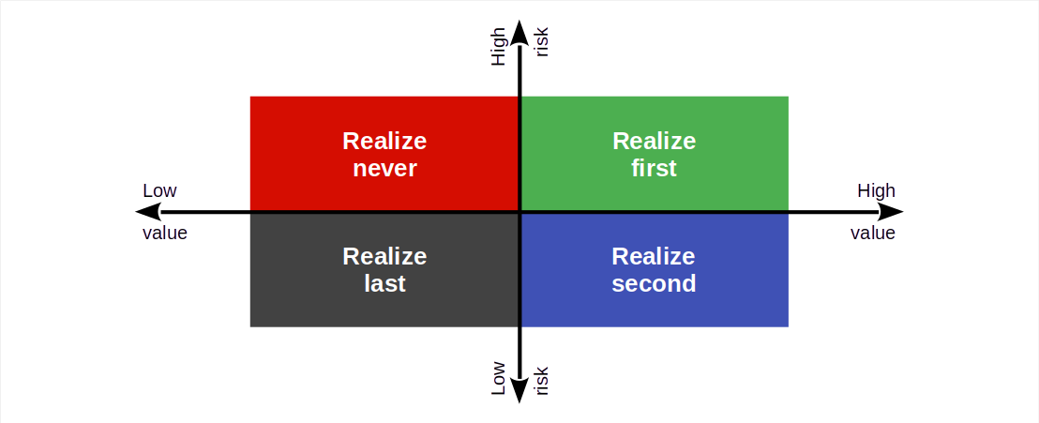
Prioritization by Risk / Reward

Slide 29
Product Backlog Item vs. Tasks
Product backlog item are
Written by a product owner
Business-value-oriented
Broken down into tasks
Tasks are
Written by a software developer
Implementation-oriented

Slide 30
5. Definition of Done

Slide 31
Definition of Done
A definition of done (DoD) is
An auditable check-list of propositions about a backlog item’s implementation
Shared by all backlog items of the same type
Typically of a technical nature
In contrast, acceptance criteria are
Specific to each backlog item
Typically of an application domain nature

Slide 32
Definition of Done Levels
Feature sign-off
Sprint release
Project release

Slide 33
Example Definition of Done for Feature Sign-off
Component tests have been written and pass
Code review has been completed and code has been merged
All feature branches have been merged and closed

Slide 34
6. Sprint Planning

Slide 36
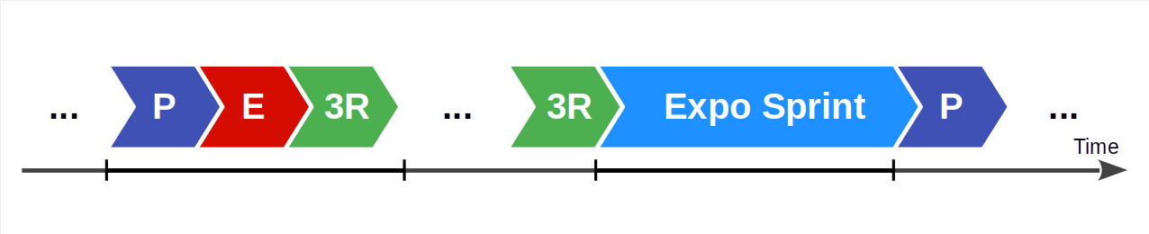
Types of Sprints
Regular sprints
Exploratory sprints
Cleanup sprints
Release sprints

Slide 37
Example Definition of Done for Sprint Release
Database update scripts succeed, consistency tests pass
Test coverage is above 70%

Slide 38
7. Release Planning

Slide 39
Example Definition of Done for Project Release
User interaction tests pass on all major browsers
Project builds, deploys, and tests successfully

Slide 40
One-Time AMOS Deliverable: Definitions of Done
Please create and agree upon definitions of done for all three types
Feel free to strengthen the definitions of done over time

Slide 41
8. Roadmapping

Slide 42
Summary
Product goal
Product glossary
Backlog items
Scrum backlogs
Definition of done
Sprint planning
Release planning
Roadmapping

Slide 43
Thank you! Any questions?
dirk.riehle@fau.de – https://oss.cs.fau.de
dirk@riehle.org – https://dirkriehle.com – @dirkriehle

Slide 44
Legal Notices
License
Licensed under the CC BY 4.0 International license
Copyright
© Copyright 2023 Dirk Riehle, some rights reserved

